Slide 1
Welcome to the
AMOS Demo Day!
Dirk Riehle, Univ. Erlangen
AMOS A02
Licensed under CC BY 4.0 International

Slide 2
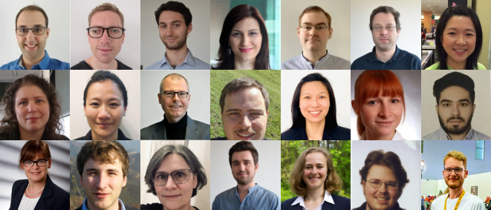
The Professorship of Open Source Software

Slide 3
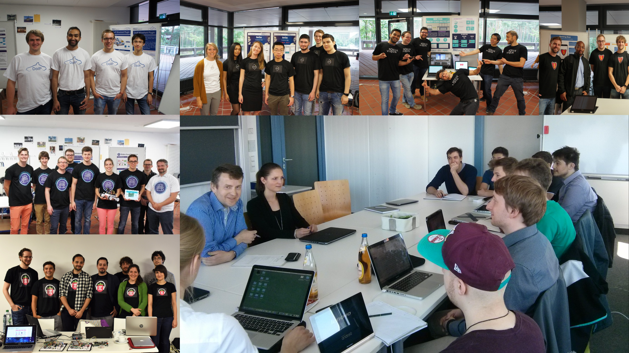

Slide 4

Industry Partners

Slide 5



Participating Universities

Slide 6
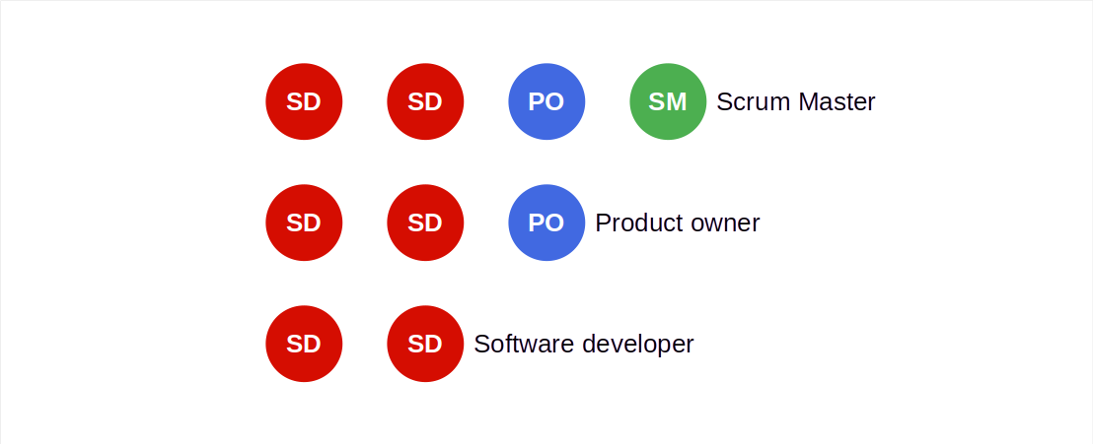
Distributed Scrum Teams

Slide 7
This Semester’s Projects
# | Project | Industry Partner
1 | Apache Pulsar UI | RBI
2 | Open Search Meta Data Hub | GRAU DATA
3 | QAchat | QAware
4 | Kubernetes Inventory Taker | Icinga / Netways
5 | QDAcity Sandbox | QDAcity

Slide 8
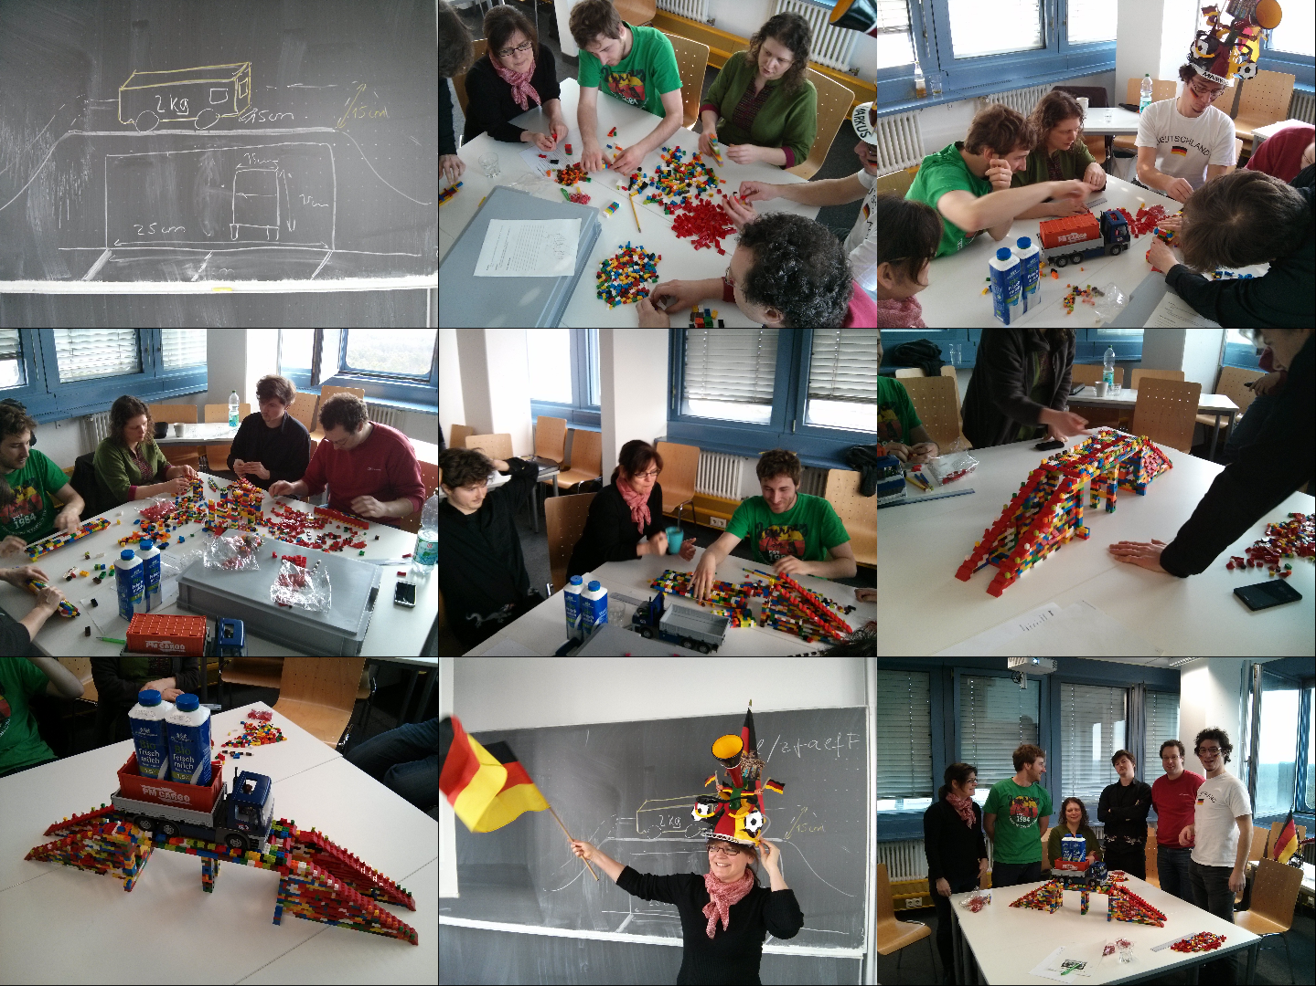
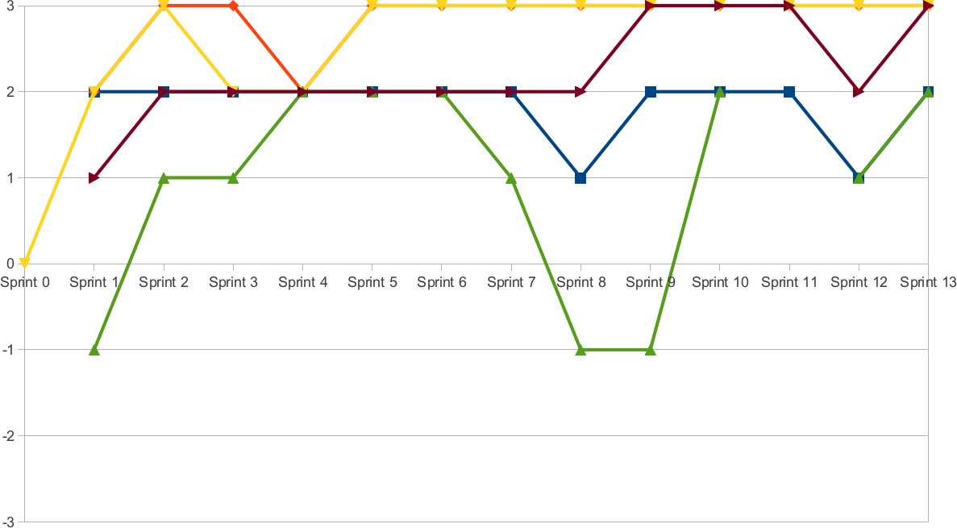
Project Coaching and Support

Slide 9
Demo Day Schedule
Time | Duration | Responsible | Title | Room
10:15 | 10 min | Riehle | Introduction | Main room
10:25 | 10 min | Teams | One slide summary | Main room
10:35 | 20 min | Teams | Demo | Demo rooms
10:55 | 20 min | Teams | Demo | Demo rooms
11:15 | 20 min | Teams | Demo | Demo rooms
11:35 | 20 min | Teams | Demo | Demo rooms
11:55 | 5 min | Riehle | Conclusions | Main room

Slide 10
Let’s go see the demos!
Please join a breakout session

Slide 11
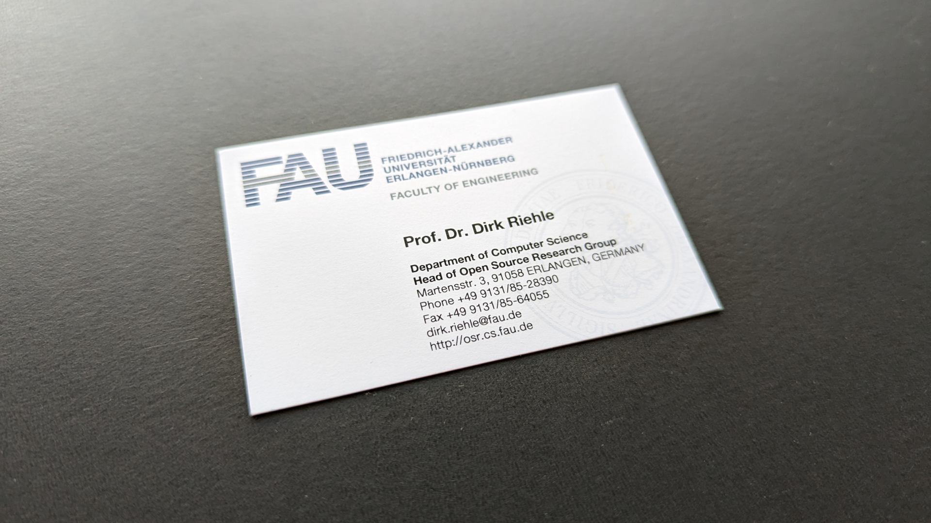

Slide 12
Thank you! Any questions?
dirk.riehle@fau.de – https://oss.cs.fau.de
dirk@riehle.org – https://dirkriehle.com – @dirkriehle

Slide 13
Legal Notices
License
Licensed under the CC BY 4.0 International license
Copyright
© Copyright 2023 Dirk Riehle, some rights reserved

